Slide 1
E-commerce Customer Behavior Analysis and Business Insights
Srilekha Mallela

Slide 2
Problem Statement
In the highly competitive e-commerce industry, understanding customer
behavior is essential for improving sales and customer satisfaction. However,
businesses often struggle to identify the key factors that influence customer
spending, engagement, and retention. This project aims to analyze custome
data to uncover patterns in purchasing behavior, evaluate the impact of
discounts and membership types, and provide insights that help businesses
make data-driven decisions.

Slide 3
objective
To analyze customer behavior in an e-commerce
platform and identify key factors influencing
customer spending, satisfaction, and retention.
To examine the impact of discounts and membership types on customer spending
To identify patterns in customer satisfaction and purchasing behavior
To provide data-driven insights for improving business decisions

Slide 4
Dataset Overview
The dataset contains detailed information about customer behavior in an e-commerce platform, including demographics, purchasing patterns, and satisfaction levels.
Customer ID – Unique identifier for each customer
Age & Gender – Demographic details City – Location of the customer Membership Type – Gold, Silver, Bronze
Total Spend – Total amount spent by the customer
Items Purchased – Number of items bought
Discount Applied – Whether discount was used
Average Rating – Customer rating (0–5)
Days Since Last Purchase – Customer activity level Satisfaction Level – Satisfied, Neutral, Unsatisfied

Slide 5
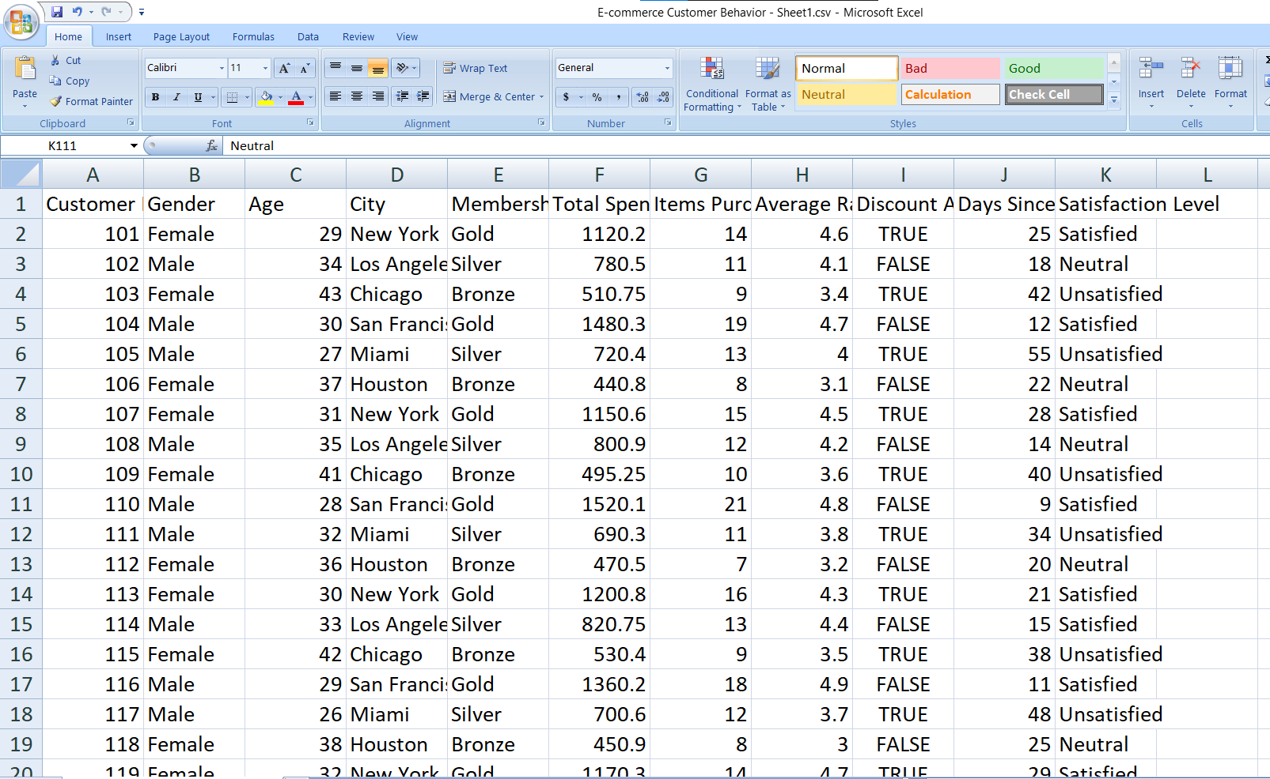
Data set view

Slide 6
Tools & Technologies
Python
Pandas
Matplotlib
Seaborn
Statistical Testing (T-test)

Slide 7
Data Analysis Approach
Steps Followed:
Data Cleaning Removed inconsistencies, handled missing values, and formatted column names
Exploratory Data Analysis (EDA) Analyzed patterns in customer behavior using statistical summaries
Data Visualization Created charts (bar plots, histograms, boxplots) to understand trends
Feature Analysis Studied relationships between variables like:
Membership Type vs Spending
Discount vs Spending
Satisfaction vs Spending
Hypothesis Testing Performed a T-test to evaluate the impact of discounts on customer spending

Slide 8
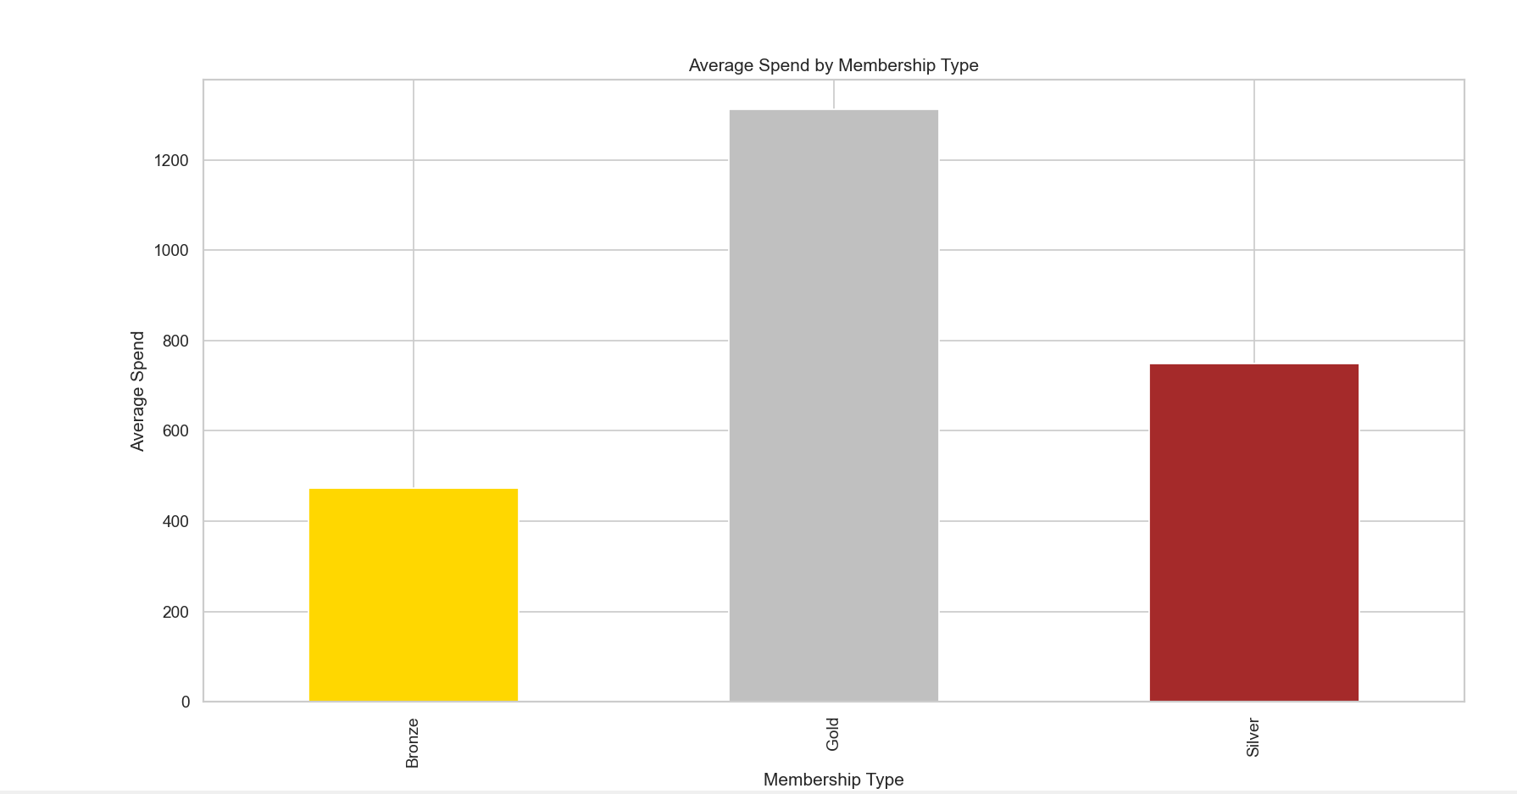
Key Insight 1

Slide 9
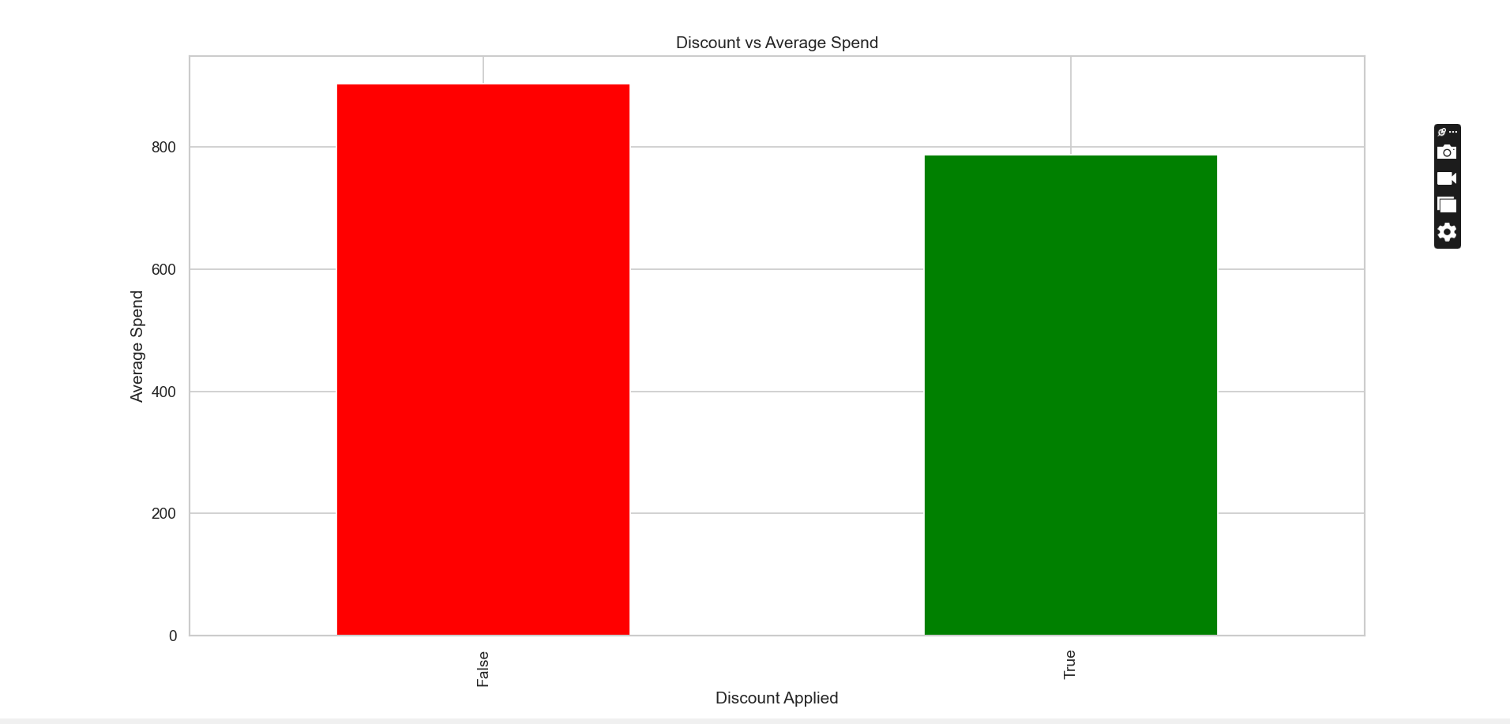
Key Insight 2

Slide 10
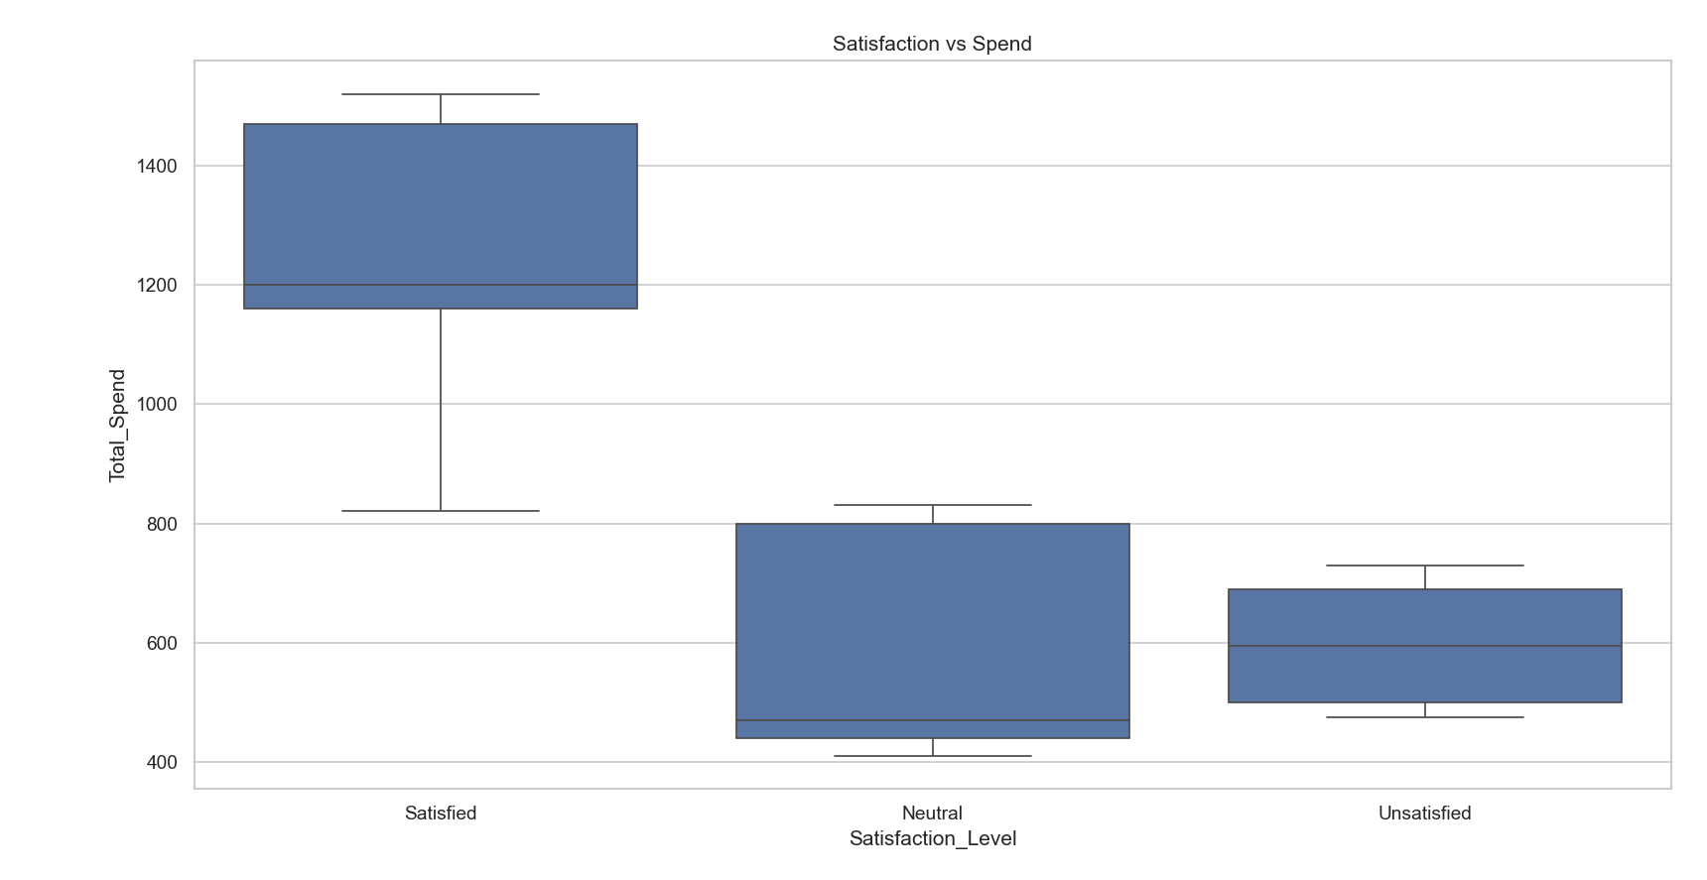
Key Insight 3

Slide 11
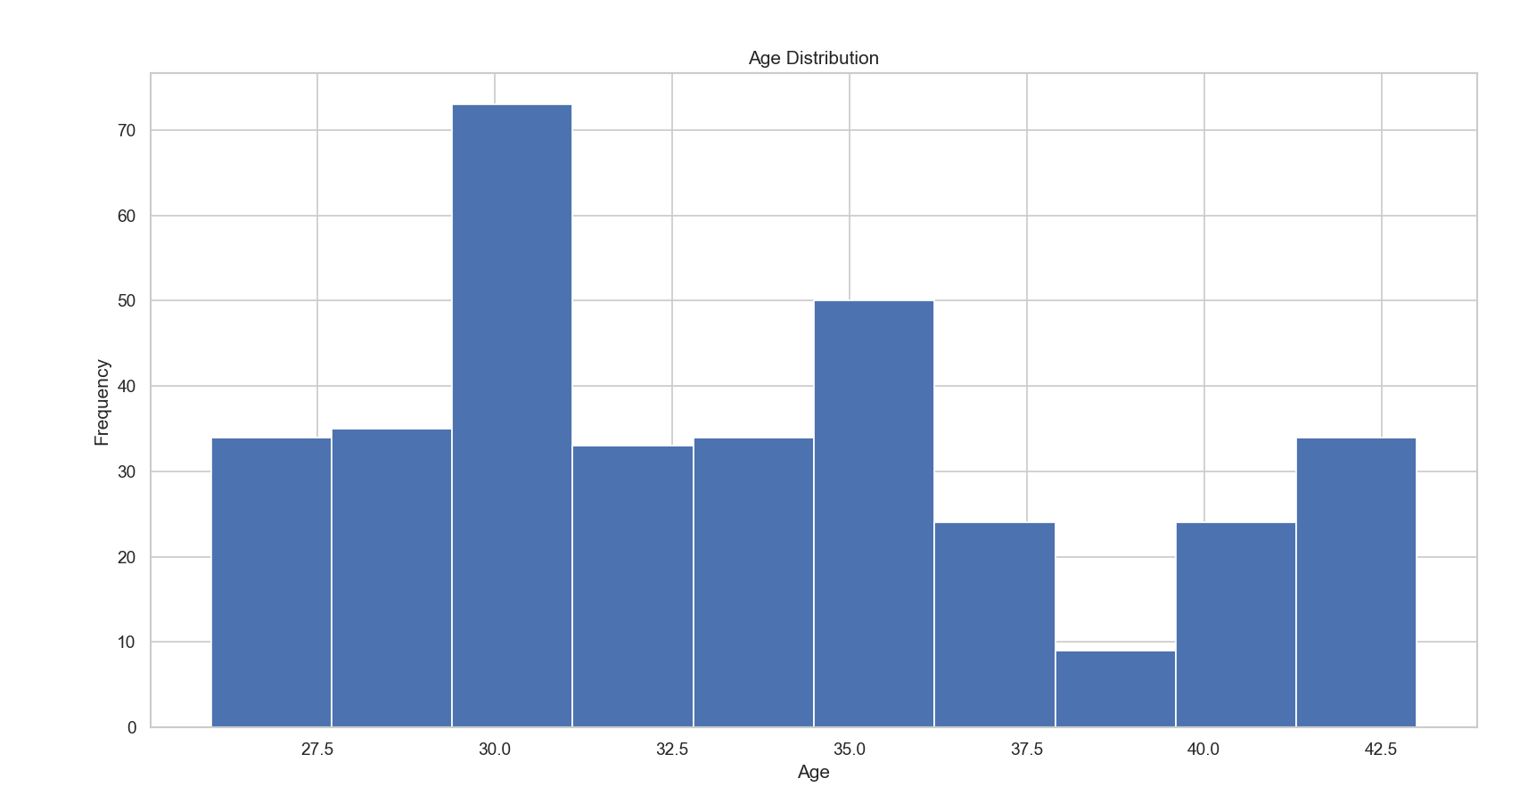
Key Insight 4

Slide 12
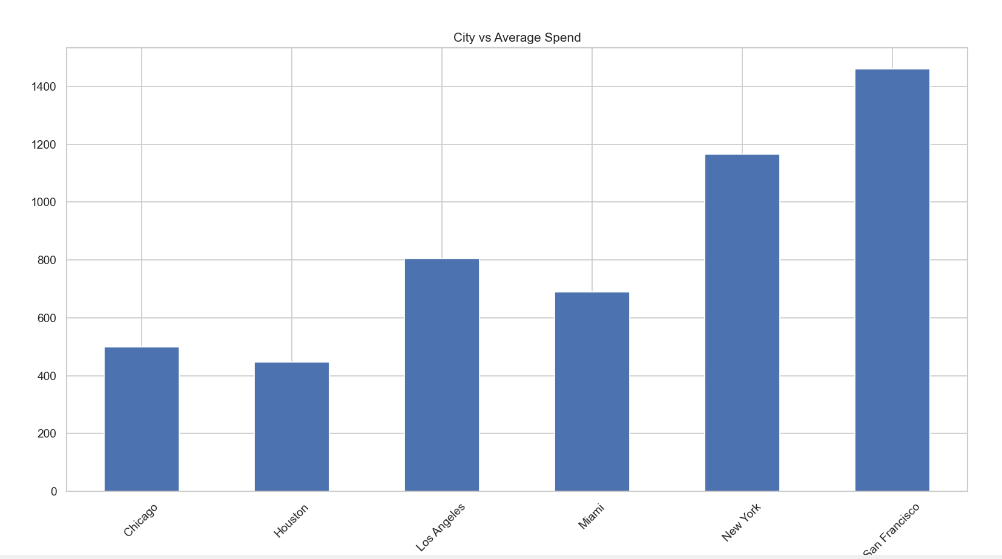
Key Insight 5

Slide 13
Hypothesis Testing
Objective:
To determine whether discounts have a significant impact on customer spending.
🔹 Hypotheses:
H₀ (Null Hypothesis): Discount has no effect on customer spending
H₁ (Alternative Hypothesis): Discount significantly affects customer spending
🔹 Statistical Test Used:
T-test (Independent Sample T-test)
Compared average spending of:
Customers with discount
Customers without discount
🔹 Results:
T-statistic: (add your value)
P-value: (add your value)
🔹 Conclusion:
👉 If p < 0.05:
Reject H₀ — Discounts have a significant impact on customer spending
👉 If p > 0.05:
Fail to reject H₀ — Discounts do not have a significant impact

Slide 14
Results and Discussion
🔹 Key Results:
Customer spending varies significantly across different membership types
Discounts influence customer purchasing behavior
Satisfied customers tend to spend more
A portion of customers shows inactivity, indicating retention challenges
🔹 Statistical Result:
👉 Based on hypothesis testing:
P-value = (add your value)
✔ If p < 0.05:
Discounts have a statistically significant impact on customer spending
✔ If p > 0.05:
Discounts do not have a statistically significant impact

Slide 15
Business Recommendations
1. Implement Targeted Discount Strategies
Offer discounts to specific customer segments
Use data to identify customers more likely to respond
🔹 2. Focus on High-Value Customers
Prioritize Gold membership customers
Provide exclusive offers and loyalty benefits
🔹 3. Improve Customer Satisfaction
Address issues faced by unsatisfied customers
Enhance product quality and customer service
🔹 4. Re-engage Inactive Customers
Target customers with high Days Since Last Purchase
Use personalized emails, offers, and reminders
🔹 5. Optimize Marketing Based on Insights
Use city and demographic data for targeted campaigns
Focus on high-performing regions

Slide 16
Conclusion
This project analyzed customer behavior in an e-commerce platform to identify key factors influencing spending and satisfaction. The results show that membership type, discounts, and customer satisfaction play a significant role in purchasing behavior. Statistical analysis further validated the impact of discounts on spending. These insights can help businesses improve customer engagement, increase revenue, and make data-driven decisions.

